Slide 1
Talent Marketplace
Your journey starts here
Billet Owner Guide:
How To Approve Tour Length Determination in TM by Wing CC/Equiv

Slide 2
What
Beginning October 1, 2022, HQ ARPC AGR Management will require tour length determination and extension approval authority which will reside with the wing commander or equivalent and above. Initial tour lengths may be advertised for durations of 2, 3, 4, or 5 years as determined by WG/Center/MAJCOM or above commanders. In TM the Wing CC, equivalent, or higher will be able to accomplish this through the Remarks Feature in the Bidding Process.

Slide 3
Why?
CAFR Memo AGR Program Changes:
All AGR positions will be changed to term, and tour length determination and extension approval authority will reside with the wing commander or equivalent and above. Initial tour lengths may be advertised for durations of 2, 3, 4, or 5 years as determined by WG/Center/MAJCOM or above commanders. Tour extensions require authorization from the aforementioned leadership but may not exceed a total tour length of five years. The position must then be re-advertised, allowing all qualified Airmen the opportunity to apply, including the incumbent. Incumbents may not apply if the position is defined for officers as Key, Command, and Joint (KCJ) or for enlisted as Key and Strategic (KS).

Slide 4
Note: You will Receive a system generated email from MyVector that there are volunteers ready to bid
*IMPORTANT* Close out dates are set at 2359 Coordinated Universal Time (UTC)/1959 Eastern Standard Time (EST)
Note 1: One system notification is sent at the end of day, if there is an action required.
Note 2: If you are not receiving notifications, please check your email information located in
your MyVector profile. For other issues, submit a Support Ticket under “Help”.
Bidding close-out set by Assignment Team

Slide 5
How? Wing/CC Approve Tour Length Determination in TM
STEP 1. Logon to MyVECTOR (Use Chrome or Edge)

Slide 6
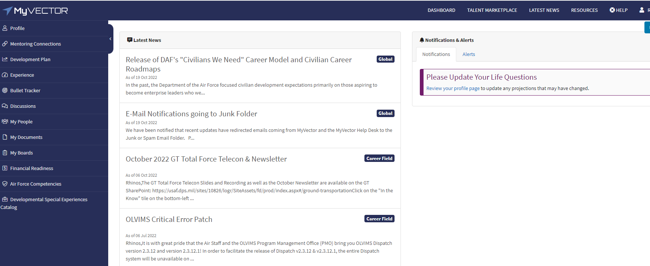
Wing/CC Approve Tour Length Determination in TM
Step 2. Click on TALENT MARKETPLACE

Slide 7
Wing/CC Approve Tour Length Determination in TM
Step 3. Click on your Billet Owner Tile

Slide 8
Wing/CC Approve Tour Length Determination in TM
Step 4. Once you are in your Billet Owner Tile. You should be able to see the positions that you are a Billet Owner for:

Slide 9
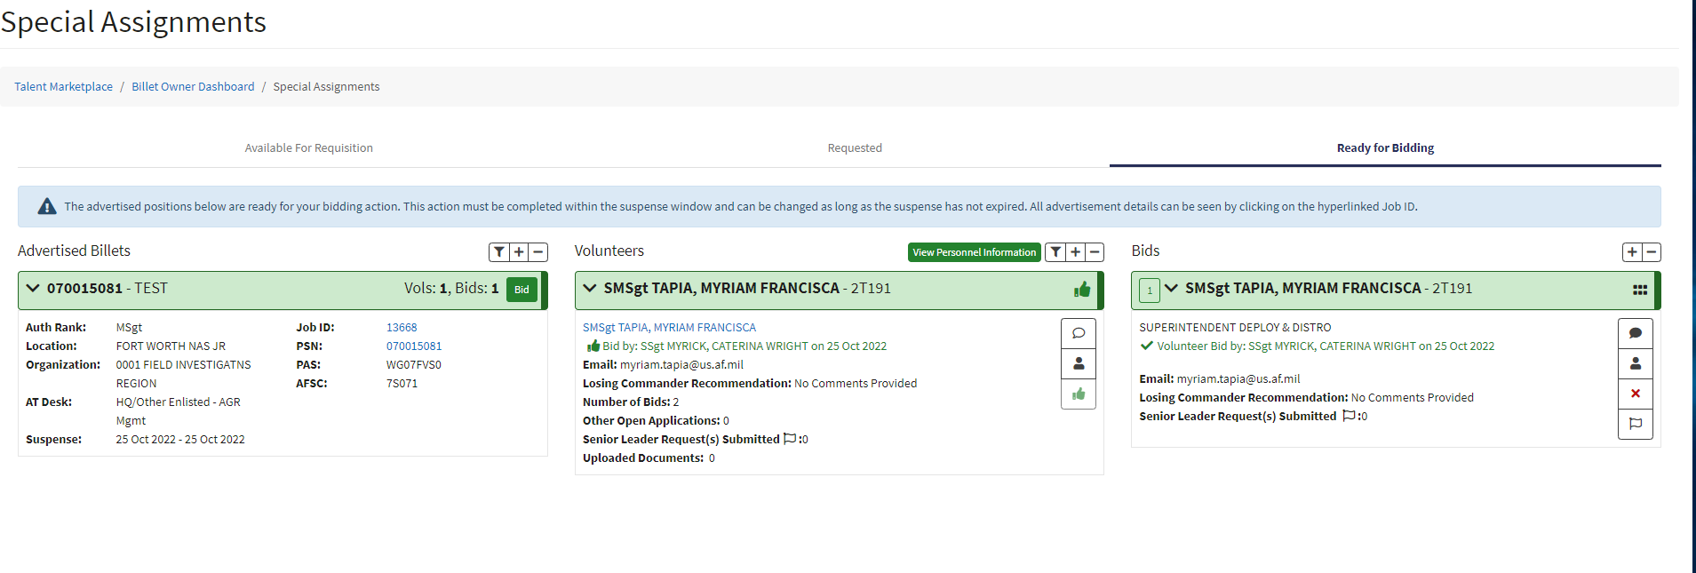
Continued
Click on ready for Bidding Tab
This will show you all your volunteers ready for selection

Slide 10
Wing/CC Approve Tour Length Determination in TM
Note: The Wing/CC or Equiv has the entire Bidding period time frame to input the standardized initial Tour length comment.
Step 6. Click on the save comments box.

Slide 11
Standard' d Texts
Example:
I Col last name, first name, mid Int. Approve the initial tour length of # AGR position for the length of number of years (2,3,4, or 5).

